Slide 1
Covalent Bonding

Slide 2
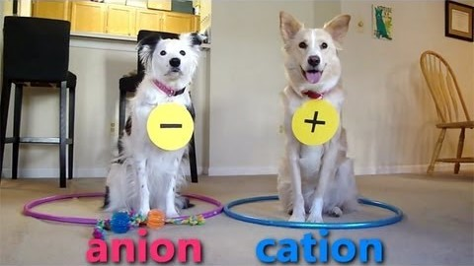
In this lesson we will be looking at when covalent bonds occur and how many covalent bonds an atom will form.

Slide 3
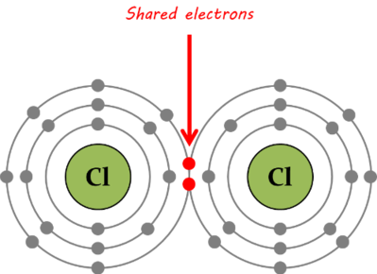
Non-metals have a very strong pull on their electrons, so they can't take them from each other.
They can, however, share them!
For example, chlorine atoms can share one of their electrons each, allowing them both to fulfil the octet rule.

Slide 4
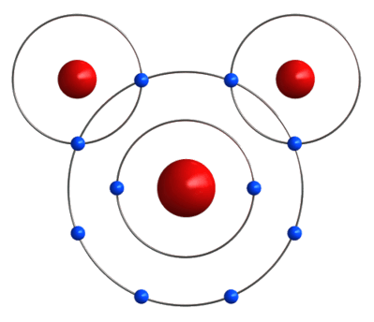
Covalent bonding occurs between non-metals.
Non-metal atoms can share valence electrons so that both atoms fulfil the octet rule.
For example, in a water molecule, hydrogen atoms need one more electron, and oxygen atoms need two. If two hydrogen atoms share one electron each, then all three atoms fulfil the octet rule!

Slide 5
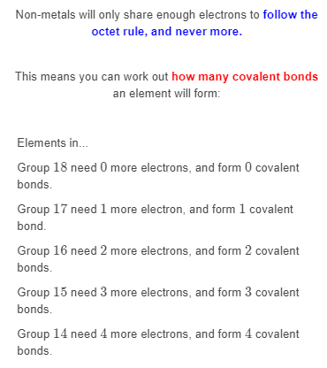

Slide 6
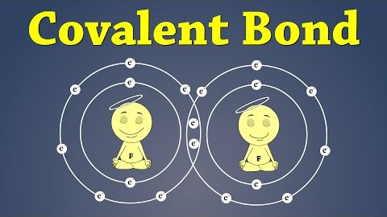
This video (1:38) helps to explain how covalent bonds are formed.

Slide 7

Watch this video (1:41) for another explanation of covalent bonding.

